Slide 1
Wireframes high fidelity responsive design - mobile
My Thai Star - Devon Example
SPRINT 1

Slide 2

Index
Menu and home
Menu sidebar
Home
Invite friends
Create invite for friends
Create reservation
Digital menu
Filter menu
Define order

Slide 3
Menu and home
MY THAI STAR

Slide 4
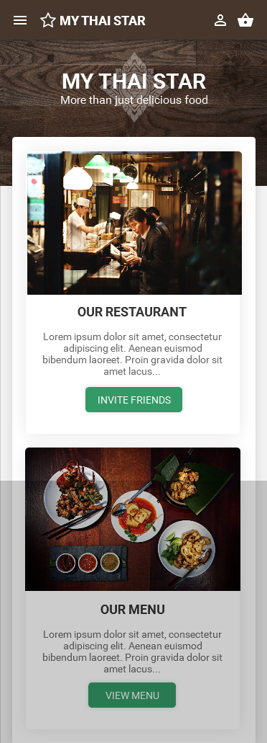
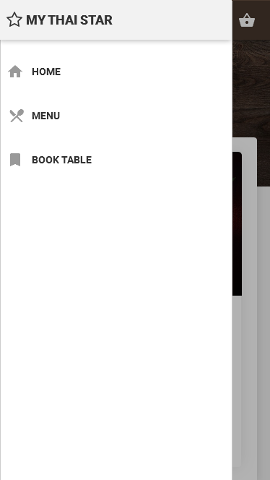
Home and menu
Open left side bar with menu
Hide area - Scroll

Slide 5
Invite friends
MY THAI STAR

Slide 6
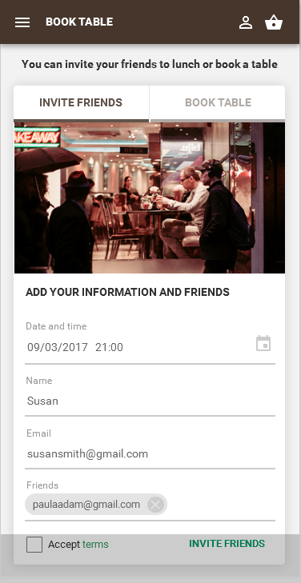
Invite friends: Create invite for friends
Tab menu: invite friends or book table
Hide area - Scroll

Slide 7
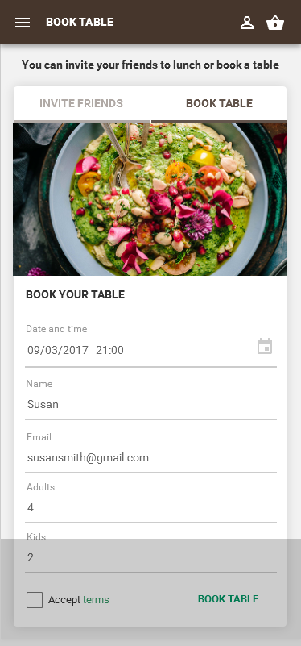
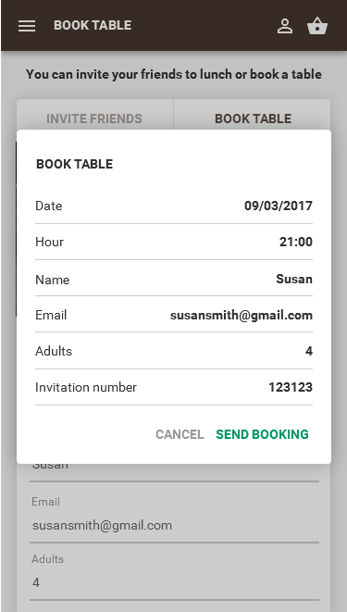
Invite friends: Create reservation
Confirmation popup:
Send reservation
Hide area - Scroll

Slide 8
Digital menu
MY THAI STAR

Slide 9
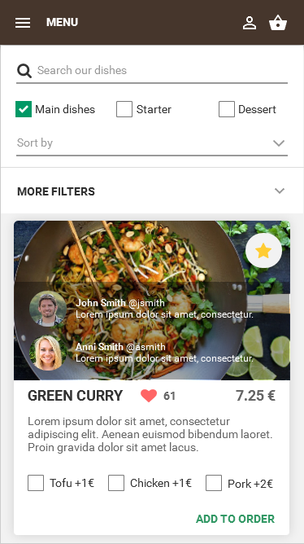
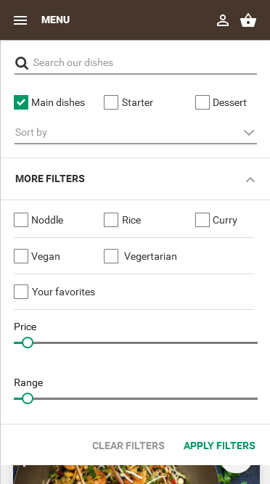
Digital menu: Filter menu
MENU UI
Filters - closed
MENU UI
Filters - opened

Slide 10
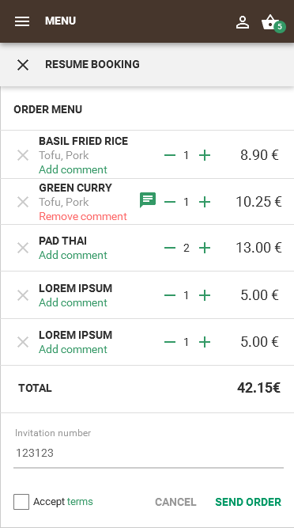
Digital menu: Define order
MENU UI
Select dishes

